Slide 1








What is
Python OOP
Python Object Oriented Programming
Renad Alnuaim
Razan Sharaf

Slide 2









About us
@RenadAbdullahN
@razan_rezo
Razan sharaf
Renad Alnuaim
Renad.alnuaim@gmail.com
razansharaf2001@outlook.com

Slide 3


Today's Schedule
01
What is Object
03
Access modifiers
02
Attributes and methods
04
Inheritance - Polymorphism
05
Mini Project : Chatbot

Slide 4



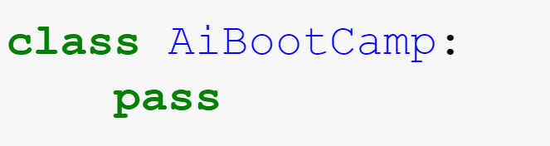

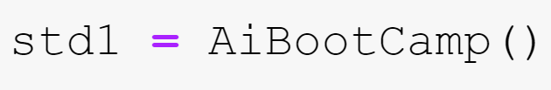

What is Object?
An instance of a class that has some attributes and methods.
But first we need a class!!
Object is going to be…

Slide 5
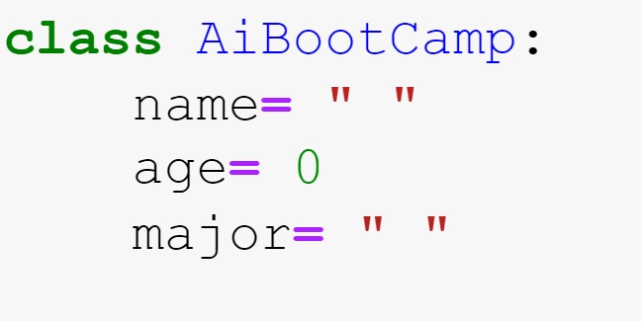
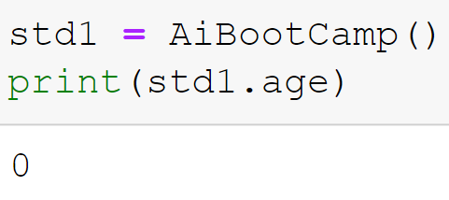
What is attributes?
They act as containers for data.
In our example, we will have 3 attributes:
Our object can access the attributes

Slide 6
What is Methods?
Set of instructions that perform a task.
Special Methods:
1- __init__() which called constructor in other languages, it is going to be executed when the class is being initiated.
2- __del__() which called destructor, it invoked when the instance ( object ) is about to be destroyed.

Slide 7
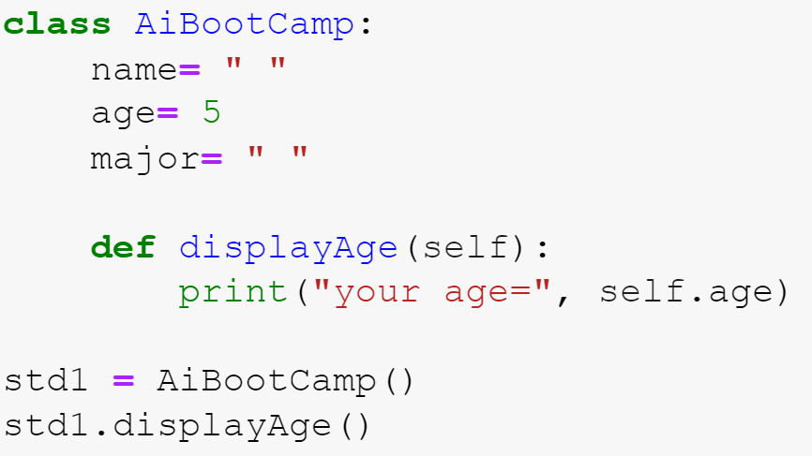
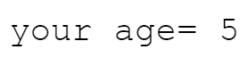
How can we access methods?
we can access the methods by calling them
Output:

Slide 8

Methods in our example
__init__()
Info()
To return the student information.
Attend()
To till that this student is attending the boot camp.

Slide 9
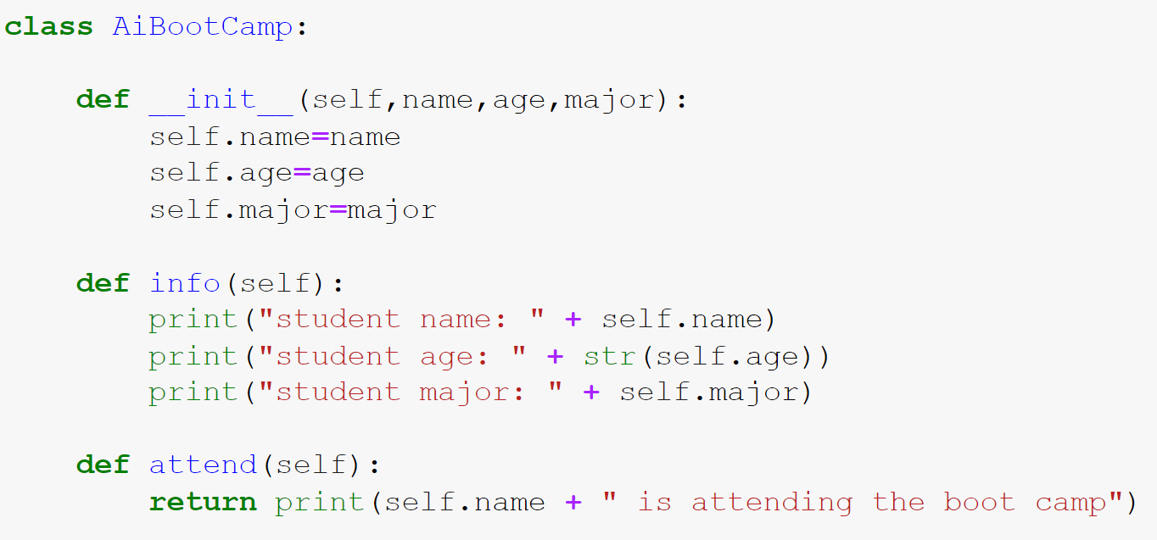


Object creation is going to be like..

Slide 10

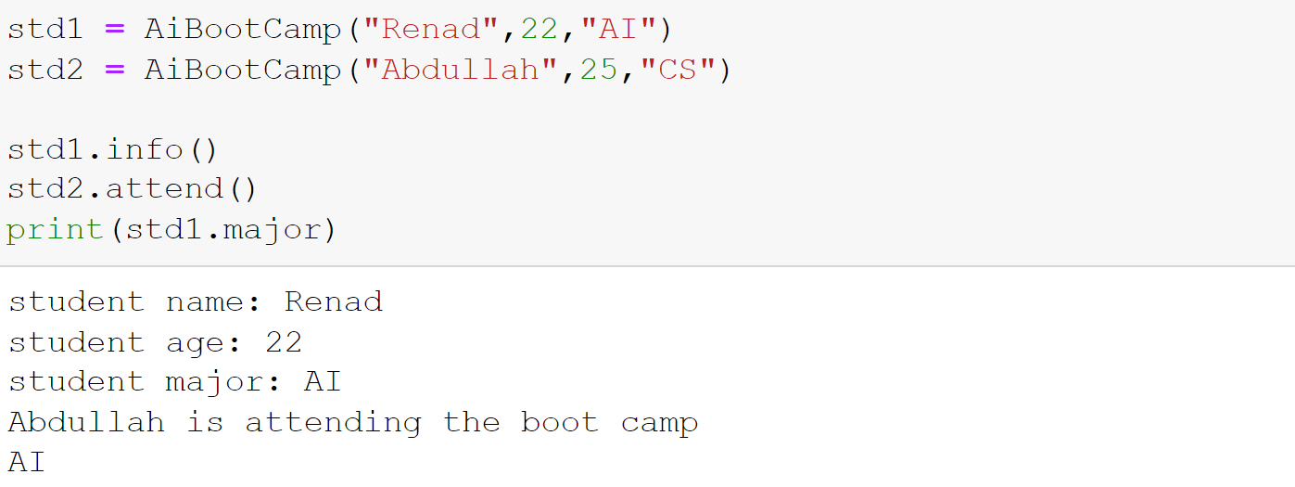
Now can you guess the output!
Output:

Slide 11
Break ( 5 minutes )

Slide 12


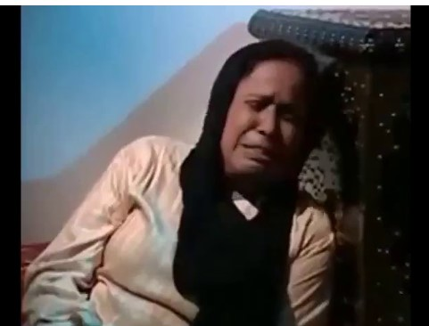



Access modifiers for methods/attributes
AI bootcamp class
The solution is
What if I want to keep my variables and
methods safe from intruders ?
Access modifiers:
used to restrict access to the variables and methods of the class.

Slide 13

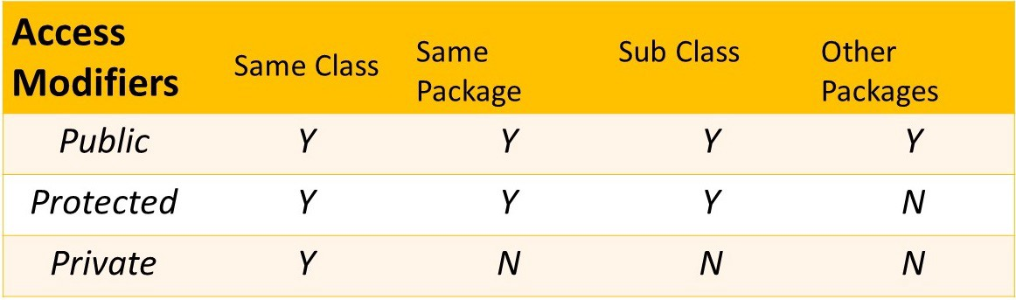

Types of Access modifiers
“Y” means attribute can be accessed in …
“N” means attribute cannot be accessed in …
protected
private
public

Slide 14

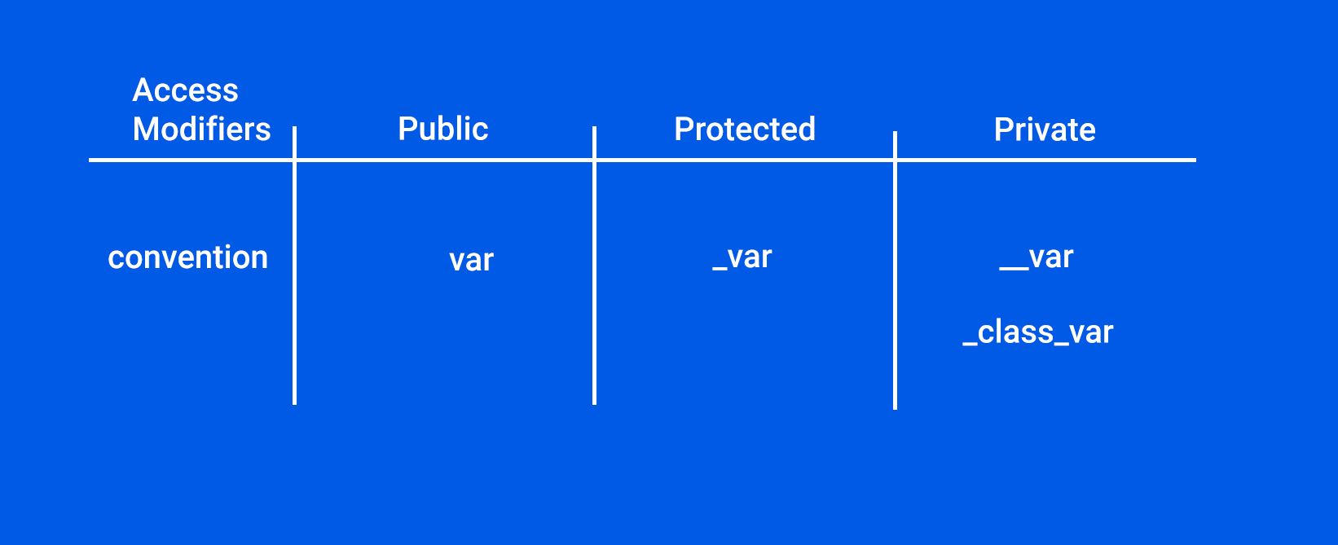



Access modifiers : Conventions
“
How can we access the private and protected methods/attributes if they are not accessible in specific positions??
By getters and setters

Slide 15
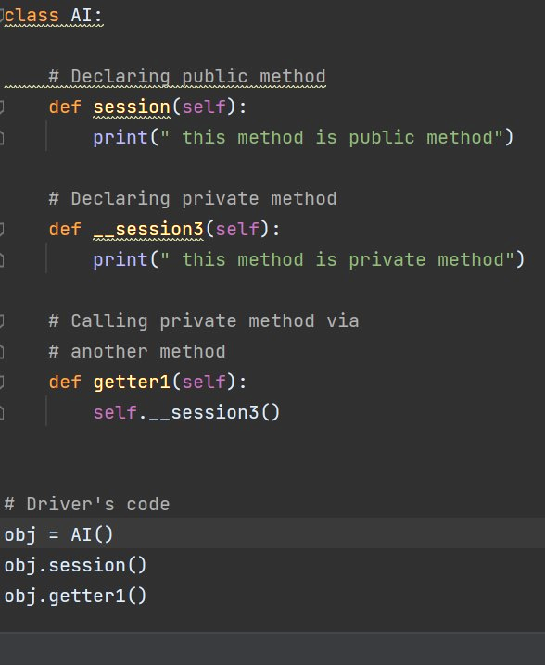
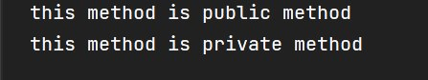
Private and public access modifiers example:
Output:

Slide 16
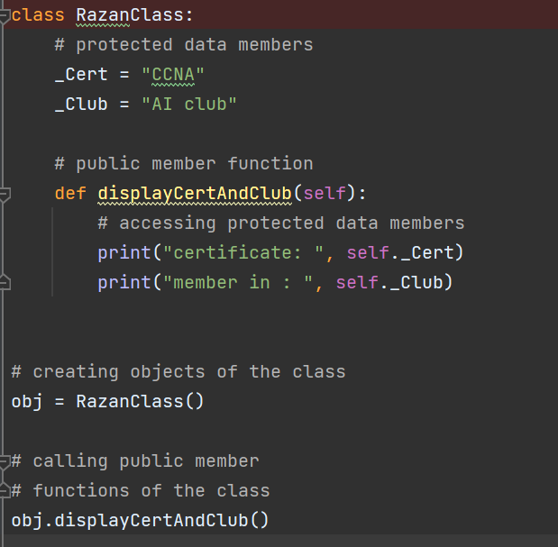
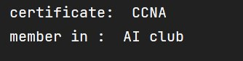
Protected access modifier example:
Output:

Slide 17



Inheritance
Parent class is the class being inherited from.
Child class is the class that inherits from another class.
Inheritance allows us to define a class that inherits all the methods and properties from another class.

Slide 18

Polymorphism
This process of re-implementing a method in the child class is known as Method Overriding.
Polymorphism lets us define methods in the child class that have the same name as the methods in the parent class.

Slide 19
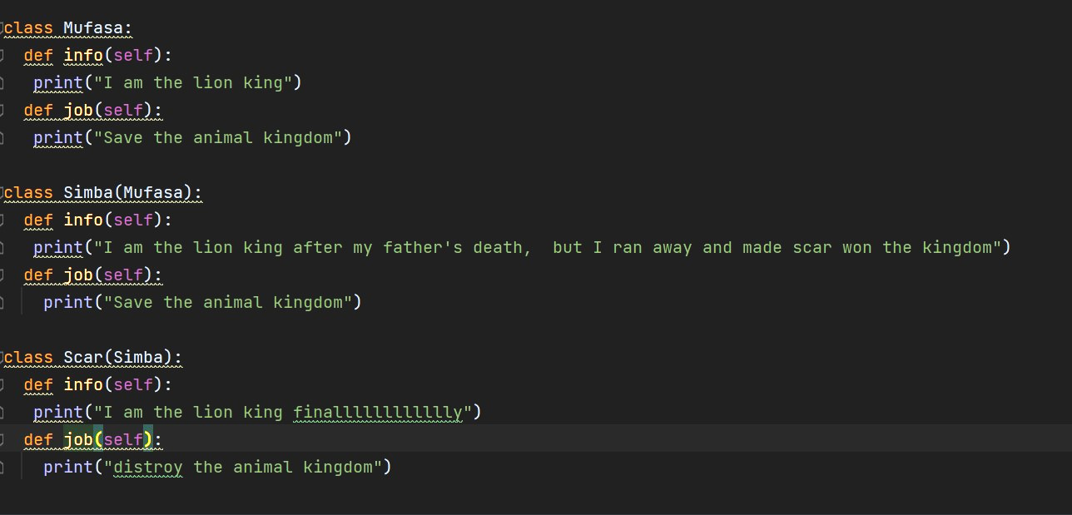
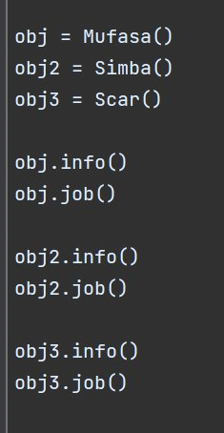
Inheritance and polymorphism example
1
2

Slide 20

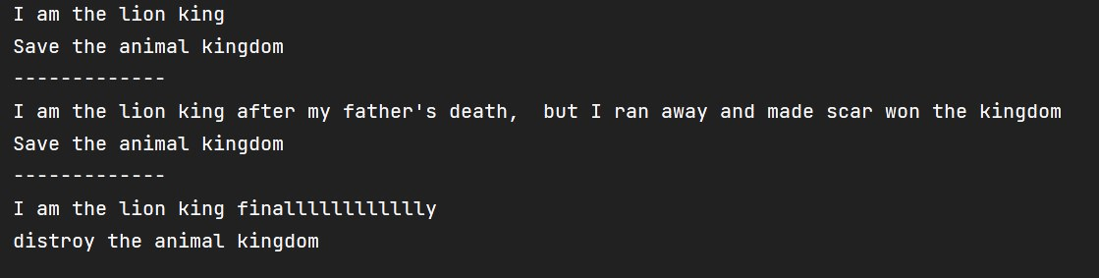


Output:

Slide 21
Break ( 2 minutes )

Slide 22

Mini project Time!
Develop your First chatbot in 5 minutes!

Slide 23

OOP Session 3 Quiz
Link
https://www.menti.com/alnbc289kcai

Slide 24

Thank You

